Slide 1
Something more on weights

Slide 2
Weights on Observations
Weighted residuals are squared and summed in the objective function:
Heads
Flows
Prior
Need to weight the observations for two primary reasons:
So that residuals for observations with different units (e.g. heads and flows) can be summed in the objective function.
To account for different observations having different degrees of measurement error. Weighting is used to reduce the influence of observations that are less accurate, and to increase the influence of observations that are more accurate.

Slide 3
Weighting schemes in UCODE_2014
Variances are rarely easy for users to understand
UCODE_2014 allows users to specify one of the following:
variance,
standard deviation, or
coefficient of variation

Slide 4
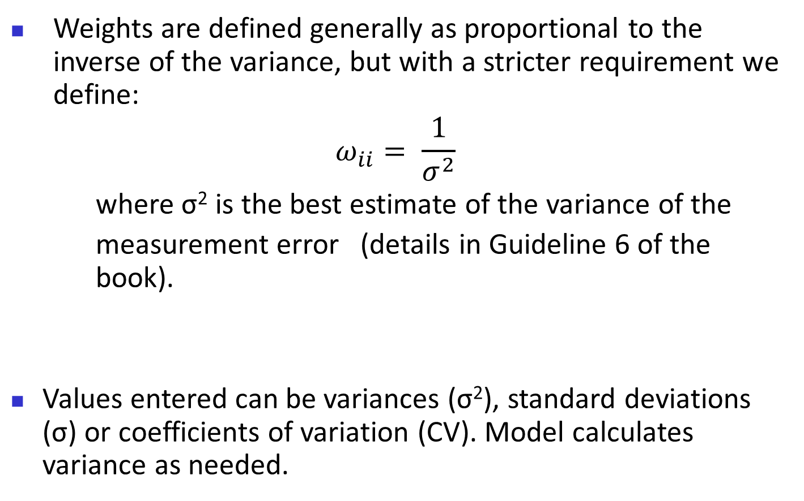
Strategy to assign the weights
Weights are defined generally as proportional to the inverse of the variance, but with a stricter requirement we define:
$$ω_{ii}= \frac{1}{σ^{2}}$$
where σ² is the best estimate of the variance of the
measurement error (details in Guideline 6 of the book).
Values entered can be variances (σ²), standard deviations (σ) or coefficients of variation (CV). Model calculates variance as needed.

Slide 5
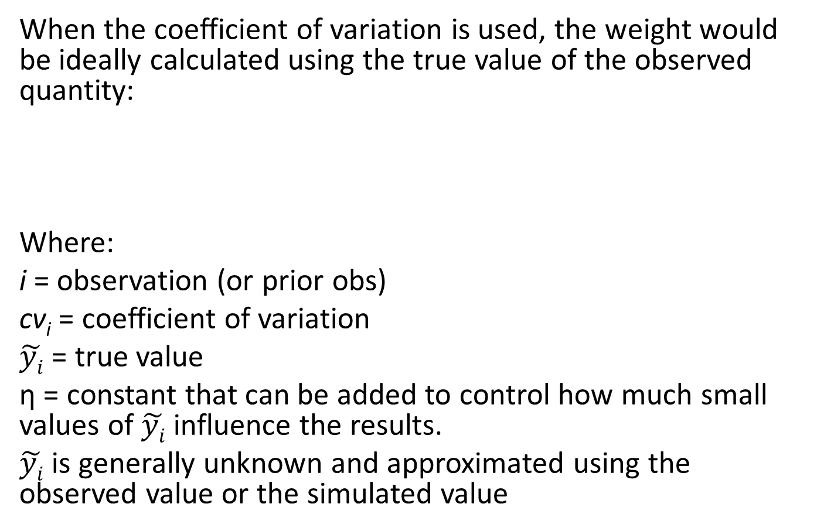
Using the coefficient of variation
When the coefficient of variation is used, the weight would be ideally calculated using the true value of the observed quantity:
Where:
i = observation (or prior obs)
cv_{i} = coefficient of variation
$\tilde{yi}$ = true value
η = constant that can be added to control how much small values of $\tilde{yi}$ influence the results.
$\tilde{yi}$ is generally unknown and approximated using the observed value or the simulated value

Slide 6
Practical suggestion…
Use the coefficient of variation mainly where there are groundwater flow and concentrations observations (spanning for example different order of magnitudes). The idea come from the fact that ERRORS are typically thought to be proportional to the TRUE VALUE:
y= y^{true} (1+ε) = y^{true} + y^{true} ε

Slide 7
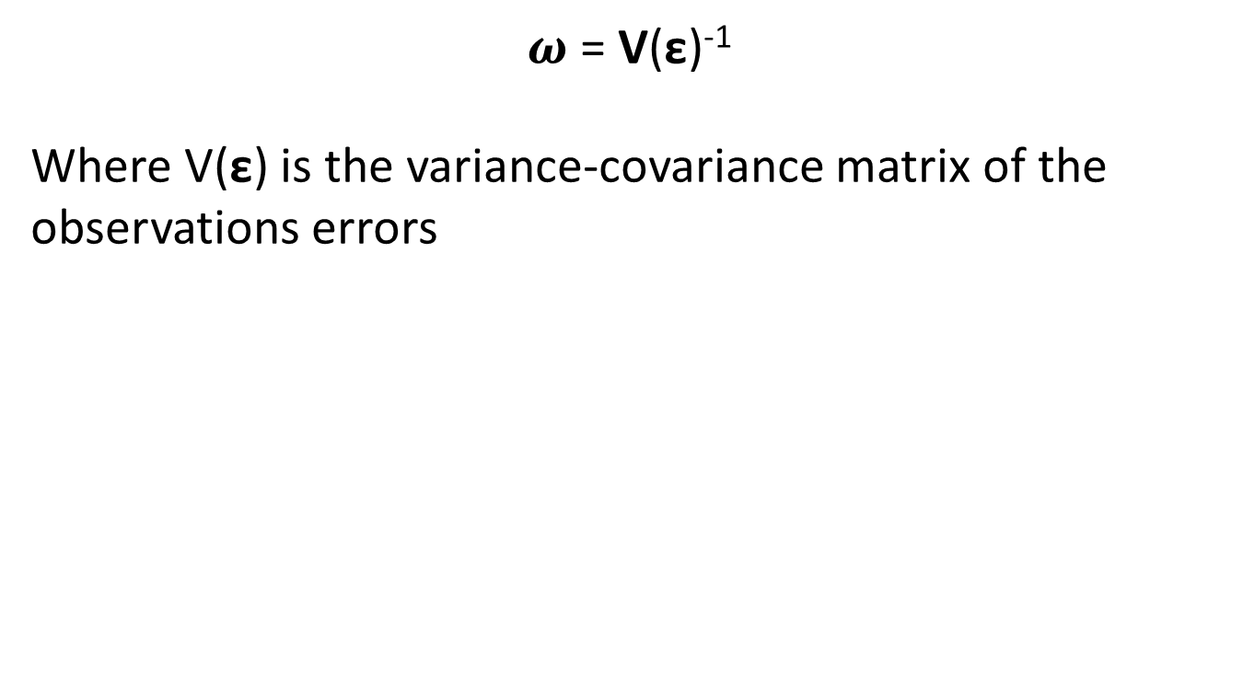
Considering the full matrix
$ω$ = V(ε)⁻¹
Where V(ε) is the variance-covariance matrix of the observations errors
Variances on the diagonal
Covariances off the diagonal

Slide 8
Weights on Observations: Example 1
A head observation is thought to be “good to within 3 meters”.
Quantify this as “there is a 95-percent chance the true value falls within 3 meters of the measurement.”
Use a normal probability table to determine that a 95-percent confidence interval is a value plus and minus 1.96 times the standard deviation, σ.
Thus, 1.96 x σ = 3 m, so σ = 1.53 m, and the variance σ² = 2.34 m².

Slide 9
Weights on Observations: Example 2
A measurement of stream loss to a ground-water system is derived by subtracting two streamflow measurements, an upstream value of 3.0 m³/s and a downstream value of 2.5 m³/s .
Quantify uncertainty: The first measurement is considered to be slightly worse than the second. For the upstream measurement, the hydrologist believes that there is a 90% chance that the true value falls within ± 5% of the measured value; for the downstream measurement, there is a 95% chance that the true value falls within ± 5% of the measured value.
Using values from a normal probability table, a 90% confidence interval is a value ±1.65 times the standard deviation, σ.
Upstream measurement: 1.65 x σ = 0.05 x 3.0 m³/σ, so σ = 0.091 m³/s.
Downstream measurement: 1.96 x σ = 0.05 x 2.5 m³/σ, so σ = 0.064 m³/s.
The loss of streamflow in the reach between these two measurements is 0.5 m³/s. How accurately is this loss known? Add variances!!
The variance of the loss is 0.091² + 0.064² = 0.0124 (m³/σ)².

Slide 10
Weights for the Steady-State Problem
Head Observations:
Elevation of each observation well has a variance of measurement error of 1.00 m².
Each water-level measurement has a variance of measurement error of 0.0025 m².
Thus, total variance measurement error = 1.0025 m²
Flow Observation:
Coefficient of variation of 10%; thus σ = 0.1 x 4.4 m³/s = 0.44 m³/s
EXERCISE 3.2d: Calculate weights on hydraulic-head and flow observations.

Slide 11
Model Fit Using Starting Parameter Values
DATA AT HEAD AND FLOW LOCATIONS
OBSERVATION MEASURED SIMULATED WEIGHTED
NAME VALUE VALUE RESIDUAL WEIGHT**.5 RESIDUAL
hd01.ss 101.804 100.225 1.579 0.999 1.577
hd02.ss 128.117 139.331 -11.21 0.999 -11.20
hd03.ss 156.678 174.363 -17.68 0.999 -17.66
hd04.ss 124.893 139.331 -14.44 0.999 -14.42
hd05.ss 140.961 157.132 -16.17 0.999 -16.15
hd06.ss 126.537 139.632 -13.10 0.999 -13.08
hd07.ss 101.112 102.868 -1.756 0.999 -1.754
hd08.ss 158.135 173.956 -15.82 0.999 -15.80
hd09.ss 176.374 190.300 -13.93 0.999 -13.91
hd10.ss 142.020 157.041 -15.02 0.999 -15.00
flow01.ss -4.40000 -4.86060 0.4606 2.27 1.047
STATISTICS FOR THESE RESIDUALS:
MAXIMUM WEIGHTED RESIDUAL: 0.158E+01 Observation: hd01.ss
MINIMUM WEIGHTED RESIDUAL: -0.177E+02 Observation: hd03.ss
AVERAGE WEIGHTED RESIDUAL: -0.106E+02
# RESIDUALS >= 0. : 2
# RESIDUALS < 0. : 9
NUMBER OF RUNS: 3 IN 11 OBSERVATIONS
SUM OF SQUARED WEIGHTED RESIDUALS : 1752.4
SUM OF SQUARED WEIGHTED RESIDUALS WITH PRIOR: 1752.4
SUM OF SQUARED, WEIGHTED RESIDUALS:
DEPENDENT VARIABLES: 1752.4
From UCODE-2014 output file.
EXERCISE 3.3: Evaluate model fit using the starting parameter values.
Least squares objective function

Slide 12
Example Least-Squares Objective Function
HEADS
FLOWS
PRIOR
nh
S
(
b
)
=
∑
ω
(
h
−
h
'
(
b
))
2
i
i
i
i
=
1
Notes:
Plyers: Vrugt, Hosin Gupta, oroosh Sorrooshian

Slide 13
Basic Steps
for Model
Calibration
Italicized steps
are affected by
using regression

